Slide 1
GUM OPTIMISATION Overview
September 2022

Slide 2





OVERVIEW
In December ‘21, we ran a “Value Discovery Lite” consisting of 2 workshops to ascertain the desirability, scalability and feasibility of the use cases
E
VALUE DISCOVERY “LITE” ACTIVITIES
VALUE DISCOVERY ACTIVITIES DURING MVP
WORKSHOP #1
WORKSHOP #2
Detailed As-Is and To-Be Journey Mapping
Value Validation and Expected Realisation
Objectives:
Determine value to be targeted with use case at Gainesville and potential scalability
Activities:
Working session to model potential savings based on site data (use case dependent – use case shared in advance as per pre-requisite)
Attendees:
Process owners at site
Site finance
Process lead in other relevant regions
Objectives:
Detail use case to enough granularity to allow MVP scoping
Activities:
Define manufacturing process to be targeted - Process mapping as is and to be
Identify intervention points that the solution will use
Determine data sources and complexity of integration
Overlay key opportunity areas, value drivers and data sources
Attendees:
Process owner at site
Technical Lead at site
Roadmap for roll-out and associated benefits
Detailed user requirements for build

Slide 3
Potential use cases
We arrived at three potential use cases that could be applicable to Yorkville and Gainesville and decided to take two of these forward into MVP.
BATCH MANAGEMENT
Automated batch reporting system for visibility of unknown issues resulting in higher quality and more consistent gum.
Out of scope
1
GUM MEASUREMENTS
Use visual inspection to measure circular LAND settings that eliminates operator subjectivity to improve the regularity of gum measurements, score depths and reduce short stops downstream in the wrapping process.
YRV
2
GUM DEFECTS
Use visual inspection to identify holes/spots & trim abnormalities to improve gum quality and reduce short stops further downstream in the wrapping process.
YRV + GNV
3

Slide 4
SOLUTION OVERVIEW

Slide 5

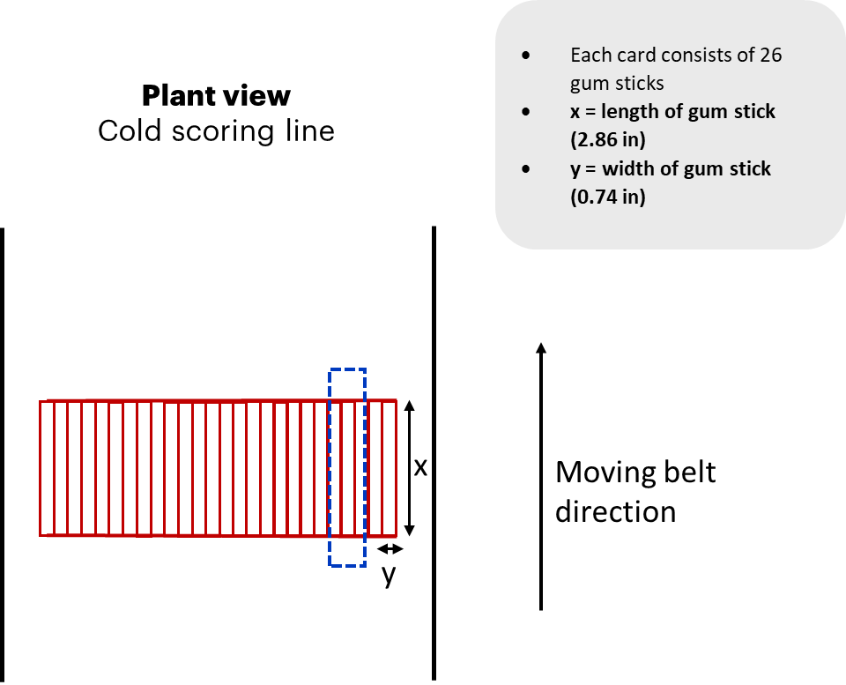
Gum Measurement YRV Solution Overview
The Challenge: To eliminate regularity of gum parameters to reduce short stops further downstream in the wrapping process. The aim is to alert operators when gum measurements are out of a defined threshold and make adjustments based on the level of error, to create product in spec.
Laser Profiler
Laser continuously measuring width and land score depth of gum sticks
Images processed by respective Keyence software on device’s controller.
Line Scan Camera + Strobe Light
Camera measuring length of gum sticks through image capture.
Images processed by respective Keyence software on device’s controller.
Cold Scoring Line
1
2
Circular Scoring Rollers (x26)
Cross-Scoring Rollers (x6)
Last Roller
LTO
Moving Belt Direction
3 Sizing Rollers applied to sheet before scoring (thickness
Cooling & Packaging
X = length of gum stick (2.86in)
Y = width of gum stick (0.74in)
Each card consists of 26 sticks
Card dimensions = 19.3in by 2.8in
Roller Balance, Scraper and Knife Position (x25)
3
Rotational encoder to synchronise camera shutter with belt movement.
1
The laser profiler continuously measures the width of the gum sticks as well as circular land score depth. The camera is placed after the Circular Scoring Rollers above and centre of the cards.
Scanning Area = 39mm (2 Circular Land Scores)
Width : Distance between score lines
Depth: Roller balance and knife + scraper settings
2
The line scanner is placed above and perpendicular to the moving belt. The camera’s shutter is synchronized to the belt movement by using a rotational encoder. When a signal from the encoder is received, the camera takes a picture.
A strobe light illuminates the back of the cards.
3
The line scanner take a series of line images and combines these to form a 3 x 2” ‘Field of View’.
Power BI Dashboard Analytics
Real-Time
Users are able to see if the length, width and land score depth of the gum stick is within a maximum and minimum threshold across a 30 minute time period.
Users can view the total number of errors above or below threshold of each type of measurement within a 30 minute time period.
Predictive
Users can see if a measurement will be above or below threshold in the next 20 minutes.
Alerts
An alert is provided when gum measurements are +/- their ideal threshold. Users can accept and reject these alerts. A reject indicates that the operator believes an error is not significant. Chosen actions are displayed on the dashboard. Alerts are considered expired after 15 mins.
Historic
Users can view the average length, width and land score depth across a selected shift or SKU. They can also drill down into the total number of errors in each run as well the median of the hours during which an error has occurred.

Slide 6
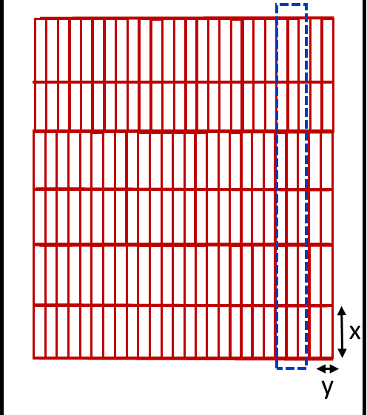
Gum Defects GNV Solution Overview
Camera 1: Area Camera
Captures image of whole gum sheet area
Camera 2: Line Scan Camera
Camera builds 2D image which displays identifiable defects
Images processed by respective software on device’s controller.
The Challenge: To identify holes/spots & trim abnormalities to improve regularity of gum parameters and prevent short stops downstream in the wrapping process. The aim is to identify which sheets have defects so that they can be removed before reaching the packaging area and causing delays.
2
Traditional Line
Circular Scoring Rollers (x26)
Cross-Scoring Rollers (x6)
Last Roller
LTO
Moving Belt Direction
3 Sizing Rollers applied to sheet before scoring (thickness)
Cooling & Packaging
Sheet = 26x6 gum sticks
130 Sheets/minute produced
1
ID of Load Production,
Current Shift
Laser Trigger Model TBD
1
The solution will aim to detect the following defects:
Holes
Ingredient Spots
Ragged Edges
and match these to the production run so that individual defected sheets can be identified.
2
The cameras are placed after the last roller with an additional light source.
The camera’s shutter speed will be synchronised with the belt’s movement to capture a single sheet of gum. The camera will capture 130 images per minute.
3
The machine learning model for automatic defect detection is to be determined depending on accuracy, complexity and time to train the model.
The model will aim to count the number of good sheets produced and identify the number of defects as they arise.
4
With time, a Power BI dashboard will be able to alert operators of gum defects before they enter packaging and reduce detection time by up to 2-3 days.

Slide 7
MVP VALUE CASE

Slide 8
Gum Optimisation Value Case - GNV
ASSUMPTIONS ARE FROM ORIGINAL VALUE CASE AND HAVE NOT BEEN VALIDATED IN COMPARISON TO THE EXISTING SOLUTION AS IT IS NOT CURRENTLY LIVE.
TOTAL LOSS
ADDRESSABLE LOSS
Non Quality Cost Avoidance
$86,203
$47,411
Avoidance of edge trim waste and waste at the cutting and packaging process.
Downtime Cost Avoidance
$324,272
$178,350
Avoidance of short stops and downtime in the packaging process.
Capacity
$383,500
$210,925
Avoidance of short stops and downtime based on 80% utilisation rate at GNV
$436,686
Gum Optimisation Value Case - YRV
TOTAL LOSS
ADDRESSABLE LOSS
Non Quality Cost Avoidance
$144,000
$79,200
Avoidance of edge trim waste and waste at the cutting and packaging process.
Downtime Cost Avoidance
$555,234
$305,378
Avoidance of short stops and downtime in the packaging process.
Capacity
TBC
TBC
Avoidance of short stops and downtime
$384,578

